Slide 1
Basic PCM

Slide 2
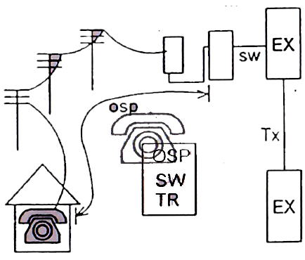
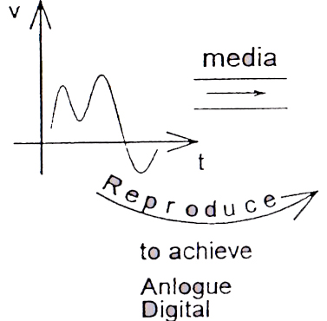
Why Telecom more Popular
Electronically dist=0
Answer only Charge
Tell No. 15 digits (Universal)
CC
AC
DN
CC- Country Code
AC- Area Code
DN- Directory No
Demarcation of Telecom
Transmission

Slide 3
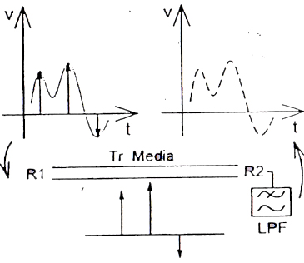
Cont…
Sampling Theorem
BL Signaling
Fs ≥ 2fm
3.
Problem to achieve Digital Tx
Noise
Tx
Media
Rx
The Samples cannot be Reproduced
Attenuation
Find a technique Digital Tx
(1) Tx Info
Rx Info
Verify the Rx Info
Verification Difficult
Tr Media

Slide 5
Cont…
Quantizing
Equate the sample to a quantize level.
Then transmit verification will be easy at the receiver
Quantizing noise is inevitable
Encoding
Convert this quantized level in to binary level
Verification will be more easy

Slide 6
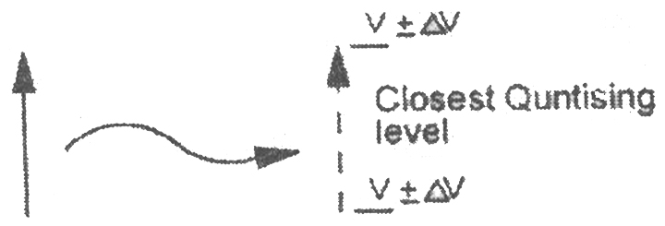
Quantizing
the samples will be equate to 1/256 levels In linear quantizing S/N is good only for high valued samples and 90% of the samples are within ½ of maximum voltages Hence linear quantizing is not used.
Hence Quantizing Noise (∆V) is inherent in PCM transmission, since there is a difference between actual sample to Quantized level.

Slide 7
Exercise 1: Convert the following denary numbers to binary(Don’t use the method of dividing by 2, use the finger method)
(a) 5 (g) 520
(b) 9 (h) 1028
(c) 16 (i) 2050
(d)33 (j) 4100
(e) 67 (k) 8200
(f) 120 (l) 16401

Slide 8
Answer to Exercise 1
(a) 5=101 (b) 9=1001
(c) 16=10000 (d)33=100001
(e) 67=1000011 (f) 120=1111000
(g) 520=1000001000 (h) 1028=10000000100
(i) 2050=100000000010 (j) 4100=1000000000100
(k) 8200=10000000001000 (l) 16401=100000000010001

Slide 9
Exercise 2 Convert the following from binary to Denary(Using fingers only)
(a) 101
(b) 110
(c) 1001
(d) 11101
(e) 100000
(f) 1011010
(g) 111000111

Slide 10
Answers to Exercise 2
(a) 101 5
(b) 110 6
(c) 1001 9
(d) 11101 29
(e) 100000 32
(f) 1011010 90
(g) 111000111 455

Slide 11
Exercise 3 Convert the following denary numbers to hexa and then to binary
(a) 9
(b) 20
(c) 36
(d) 129
(e) 518
(f) 1030
(g) 4095
(h) 8200

Slide 12
Answers to Exercise 3
Denary Hexa Binary
(a) 9 9 1001
(b) 20 14 10100
(c) 36 24 100100
(d) 129 81 10000001
(e) 518 206 1000000110
(f) 1030 406 10000000110
(g) 4095 FFF 111111111111
(h) 8200 2008 10000000001000

Slide 13
The A law Signaling Compression and Characteristics
Segment No | Voltage Range | Voltage range | Change over to next segment | Level range | Increment per Level
7 | Vm – Vm/2 | 3072 – 1536 |  | 127 – 111 | 96
6 | Vm/2 – Vm/4 | 1536 – 768 | >1512 | 111 – 95 | 48
5 | Vm/4 – Vm/8 | 768 – 384 | >756 | 95 – 79 | 24
4 | Vm/8 – Vm/16 | 384 – 192 | >378 | 79 – 63 | 12
3 | Vm/16 – Vm/32 | 192 – 96 | >189 | 63 – 47 | 6
2 | Vm/32 – Vm/64 | 96 – 48 | >94.5 | 47 – 31 | 3
1 | Vm/64 – Vm/128 | 48 – 24 | >47.25 | 31 – 15 | 1.5
0 | Vm/128 – | 24 – 0 | >23.25 | 15 – 0 | 1.5
Less levels are located for height valued samples

Slide 14
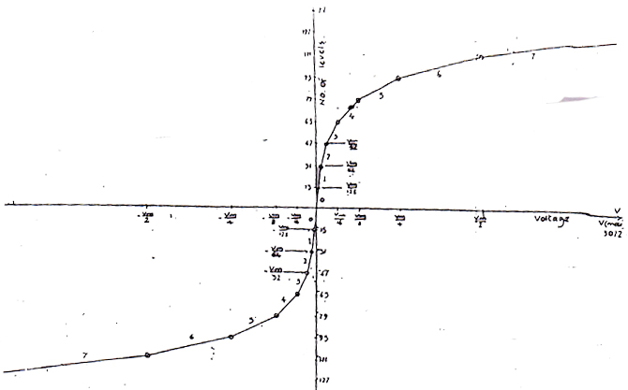
Cont…
Note : A Total of 256 quantisation steps covers line peak to peak range of nomal speech intensities
A law gives lower quantising dislortion …. Law
There are 16 segments shown in this graph positive 0,1 and negative 0,1 consai one linear segment.
hence there are 10 linear segments.
Encoded 8 bit format
S
A B C
W X Y Z
Sign
No of seg
No of pos in the Segment
If S=1 it is positive sample
If S=0 it is Negative sample
Vm – Maximum voltage = 3072 mv
N – Na of quantised levels =256
Some times ’A’ low is named as Eurpean law (C.E.P.T) Equation for logaribimic part y=n ln Ax / ln A (1/A<x<1)
Linear part y=Ax (0<x<1/A)

Slide 15
Encoding
The quantized level is then converted in to 8 bits. This 8 bits represent,
S ABC WXYZ
S = sign + or -
ABC = No of segments
WXYZ = No of level in that segments
Summary of process involved,
equate
To a quantize level 1/256
Convert
8 bit
Sample

Slide 16
Convert the following samples into encoded format and calculate the signal /noise ratio
700mV -400mV 300mV
100mV 1515mV -95mV

Slide 17
Answers
700mV -400mV 300mV
11011101 01010001 11001001
175 50 ∞
100mV 1515mV -95mV
10110001 11110000 0011000
25 72 295

Slide 24
WAVE FORMS IN THE TRANSMISSION LINES
RZ return to zero wave form
NRZ non return to zero wave form
RZ, NRZ AMI WAVE FORMS
CONCEPTS OF TRANSCODING
SPECTRUM ANALYSIS OF PRACTICAL WAVE FORMS
HIGH DENSITY BIPOLAR 3 CODE

Slide 25
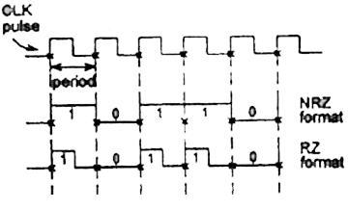
Transcoding
Code Conversion to suit for the Transmission media
Out put of a PCM System either RZ, NRZ
1 bite named as mark NRZ means, Mark will return to zero before the period of CLK pulse, but at the period of the click pulse.
RZ, means mark will NOT come to zero before the period of the CLK pulse, but at the period of the CLK pulse if the following is not a MARK.

Slide 26
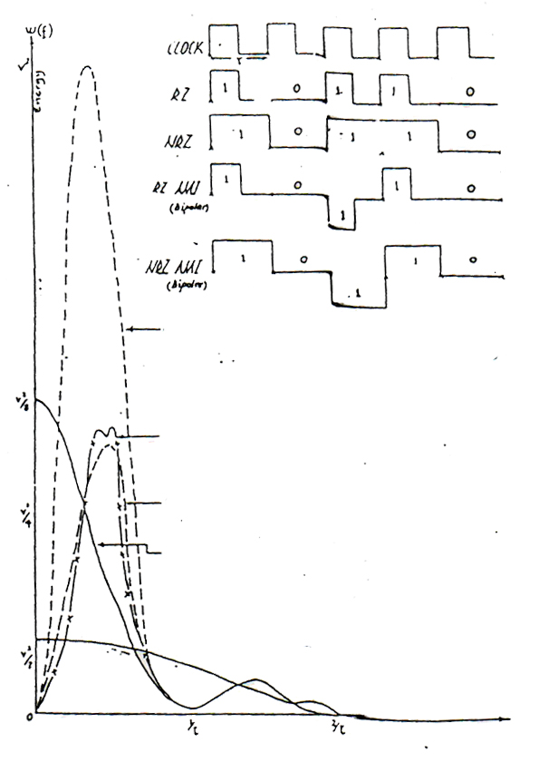
Difference Codes used in digital Transmission
Frequency

Slide 27
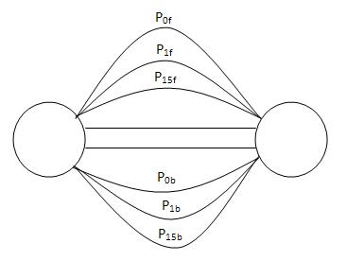
Question ?
Q 1.
1. List out the different phases of a call?
2. Label the voice time slots?
3. Draw the messages exchange with regards to successful call?
4. Calculate the time taken to establishment the call?
5. Assuming each call will establish for 3 minutes conversation time. How many
conversations can be establish?
6. Discuss how this concept is extend the packet switching networks?
Q 2. Draw 101101 in NRZ and RZ and in AMI format

Slide 28
Answer Q2.
NRZ
RZ

Slide 29
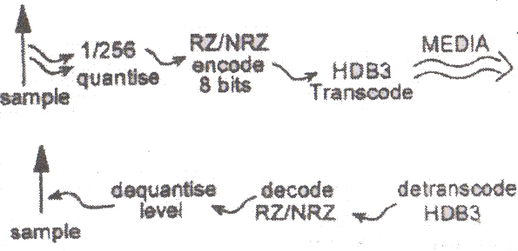
Practical Transcording wave Forms High Density Bipolar 3.
Rules
1. Don’t allow more than 3 Consecutive Zero’s to be present in the wave form (media). Introduce a violation bit. Violation bit has to be of the same polarity of the previous MARK.
2. Two Consecutive violation bits has to be of opposite polarity.
3. Between two consecutive violation bits if there are even number of last violation will be boove where B is the stuffing BIT and will be of opposite polarity to the previous MARK.
Process Involved

Slide 30
HDB3 Rules
Rule 1 : Don’t allow more than 3 corrective zero’s to be present in the wave form, for the 4th zero introduce a violation bit
Assume the bit stream is as follows,
100001 Normally 1⁺oooo1⁻
Under HDB3 before transmitting convert the bit stream, according to rules,
1⁺000 1⁺ 1⁻
Then transmit assume the same bit stream received
How the receiver detranscode - 1⁺0001⁺1⁻
If knows it is a violation hence convert to
1⁺0001⁺1⁻
100001
0
Transmitted bit stream has been received correctly

Slide 31
Rule 2 :
Two consecutive violations bits of opposite polarity
Then above rule is easily followed when there are odd number of marks between two consecutive violation bits
Try : 10000100001
0 1000 0 1
1⁺0001⁺1⁻0001⁻1⁺
1⁺0001⁺1⁻0001⁻
Convert HDB₃
Transmit
Can be easily convert back to
10000100001

Slide 32
But,
if there are even number of marks between two consective violation bits addition sub rule to be introduce to follow above rule 2. for the last four zero’s introduce the pattern as B 0 0 V where B is the bit, where it is opposite sign to the previous mark
Assume 100001100001
1+0001+1-B+00V-1+
1+000V+ 10000
But next stream
1-1+001-
After two zero another violation
Hence the reciver willl correct this as,
100001

Slide 34
SIGNALLING
BASIC CONCEPTS OF ANALOGUGE TYPE OF SIGNALLING
HOW ANALOUGE TYPE OF SIGNALLING ADOPTED TO PRIMARY PCM
CHANNEL ASSOCIATED SIGNALLING
BASIC FUNCTIONAL BLOCKS IN PCM ADOPTED FOR ANALOUGE TYPE OF SIGNALLING
COMPONENTS OF A PCM EQUIPMENT

Slide 35
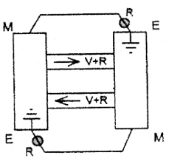
Cont…
Supervisory
Signaling
Analog
Register
Characteristics
Supervisory is always present with voice.
Register is always prior to voice hence analogue channel
exchange will be as follows.
Exchange to another exchange will be as follows
V = Voice
R = Register
Sup. Signals are on M, E, Wires

Slide 39
Cont…
Multiframe in a PCM SYSTEM for supervisory signals only
TS16 is available. CCJTT has allocated 4bits for each channel.
To send 30 channels supervisory signals on TS16, You need
15 frames.
To align SIG TR module to SIG RX module one TS16 is used.
Hence Multiframe consist 16 Frames.
f0
MF Sys
f1
CH1
CH17
f2
CH2
CH18
2 ms
f15
CH15
CH31

Slide 40
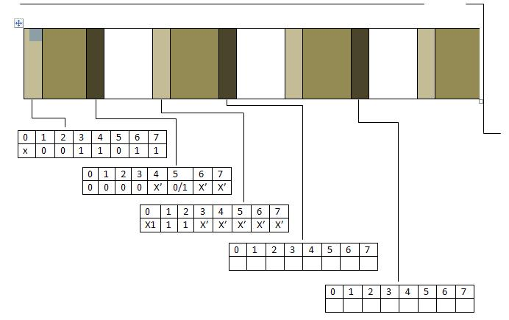
Structure of Multiframe
One Multiframe= 16 Frames
TS 1-15
TS 17-31
Practical Channels
TS 0
TS 16
1
TS 0
TS 0
TS 0
2
15
17
31
F0 TS16 is used for Multiframe alignment all other TS16 are used for Channel Associated signaling
There are two kinds of synchronization words odd and even
Odd actually synchronization Even alarm signaling

Slide 42
Pcm equipment

Slide 43
Pcm equipment(2) contd

